Slide 1





CO1 AT-3
TECHNICAL PRESENTATION
E.Jeffrey Samuels
192524412
B.Tech AI&DS
CSA - 0504

Slide 2
1) Create and present an ER diagram for an Online Library System, explaining each component clearly.

Slide 3
Introduction to Online Library System
An Online Library System manages books, members, and
borrowing activities.
The ER diagram represents the database structure visually.
It identifies entities, attributes, and relationships.
It helps design an efficient and organized database.
It minimizes data redundancy and improves data consistency.

Slide 4
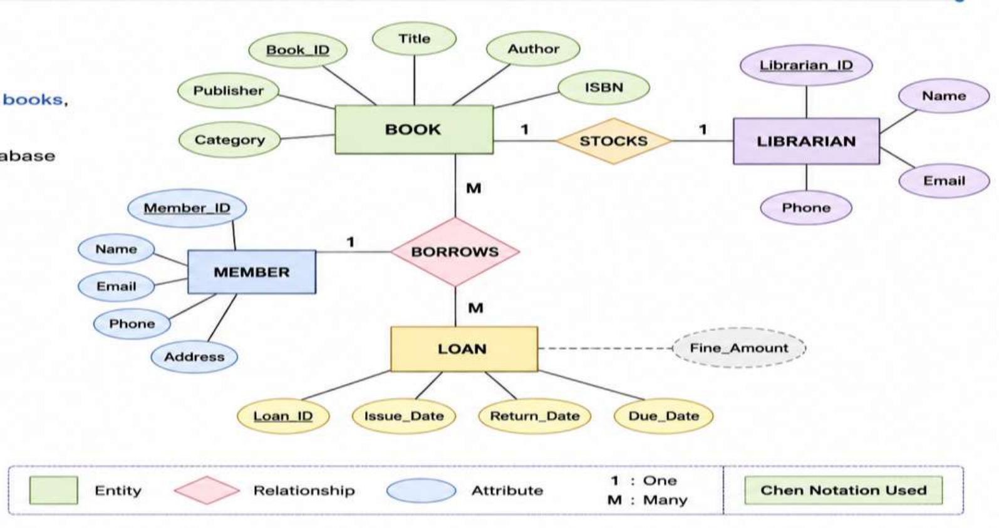
ER Diagram for an Online Library System

Slide 5
Entities and Attributes
Main Entities
Book
Member
Librarian
Loan
Key Attributes
Book: Book_ID, Title, Author, ISBN
Member: Member_ID, Name, Email
Librarian: Employee_ID, Name
Loan: Loan_ID, Issue_Date, Return_Date

Slide 6
Relationships in ER Diagram
Relationships among Entities
A Member borrows many Books.
MEMBER
|
A Book can be borrowed by different Members over time.
Borrows
A Librarian manages book issue and return.
|
BOOK
A Loan records borrowing transactions.
Relationships define how entities interact.
BOOK
|
Recorded In
|
LOAN

Slide 7
Advantages and Complete ER
Diagram
Benefits of ER Diagram
Simplifies database design.
MEMBER -------- BORROWS --------
BOOK
Reduces duplicate data.
| |
| |
Improves data integrity.
-------- LOAN -------- LIBRARIAN
Makes future database modifications easier.
Supports efficient query processing.

Slide 8
Q2. Prepare a presentation on the EER model,
demonstrating generalization and
specialization with a University case study.

Slide 9
Introduction to EER Model
Enhanced Entity Relationship (EER) Model
EER is an extension of the ER model.
It supports more complex database designs.
It introduces Generalization and Specialization.
It models inheritance among entities.
It represents real-world scenarios more accurately.

Slide 10
Generalization
Bottom-up approach.
Combines similar entities into one superclass.
Common attributes are moved to the parent entity.
Professor
|
Reduces redundancy.
|
Improves database organization.
Administrator
|
Employee
Common Attributes:
Employee_ID
Name
Salary

Slide 11
Specialization
Top-down approach.
Divides one entity into specialized subclasses.
PERSON
Each subclass has unique attributes.
|
Provides better classification.
-------------------
| | |
Supports inheritance.
Student Faculty Staff
Example Attributes:
Student → CGPA
Faculty → Subject
Staff → Department

Slide 12
Advantages and University Case
Study
Advantages of EER Model
Represents complex relationships.
PERSON
|
Supports inheritance.
-------------------------
Reduces data duplication.
| | |
Student Faculty Staff
Improves flexibility.
| | |
Suitable for large organizations like universities.
Roll No Subject
Department
Conclusion
The EER model enhances the traditional ER model by introducing Generalization and
Specialization, making university database design more flexible, organized, and
efficient.

Slide 13
Q3. Present the concept of data
independence (logical and physical)
and its significance in DBMS architecture.

Slide 14
Introduction to Data Independence
Data Independence in DBMS
Data independence is the ability to modify one level of the database without
affecting higher levels.
It separates logical and physical data storage.
External Level
It is achieved using the ANSI/SPARC three-level architecture.
│
Conceptual
It improves flexibility and maintainability.
Level
│
It reduces the cost of database modifications.
Internal Level

Slide 15
Physical Data Independence
Physical Data Independence
Physical changes do not affect the conceptual schema.
Applications
Storage devices or file organization can be changed.
│
Improves storage efficiency.
Conceptual Schema
│
No changes are required in application programs.
Internal Schema
Supported by the Internal Level.
│
SSD / HDD
Examples
Changing HDD to SSD.
Creating indexes.
Compressing database files.

Slide 16
Logical Data Independence
Logical changes do not affect user applications.
New tables or attributes can be added.
Student
---------
Existing applications continue working.
ID
Easier database expansion.
Name
Supported by the Conceptual Level.
↓
Examples
Student
Adding Email column.
---------
ID
Creating a new Student table.
Name
Adding new relationships.
Email

Slide 17
Significance of Data Independence
Importance of Data Independence
Physical | Logical
Internal Level | Conceptual Level
Storage changes | Schema changes
Faster implementation | More difficult
No application changes | No user view changes
Reduces maintenance cost.
Improves database flexibility.
Supports future database growth.
Protects application programs from
changes.
Makes database management more efficient.

Slide 18
Q4. Deliver a technical presentation on the
software components of a DBMS, explaining
Query Processor, Storage Manager, and
Transaction Manager.

Slide 19
Introduction to DBMS Components
Software Components of DBMS
DBMS consists of several software modules.
User
Each module performs a specific function.
│
Major components work together to process data.
DBMS
│
They ensure efficient data management.
-----------------------
Three important components are Query Processor,
│ │ │
QP SM TM
Storage Manager, and Transaction Manager.
(QP = Query Processor,
SM = Storage Manager,
TM = Transaction
Manager)

Slide 20
Query Processor
Accepts SQL queries from users.
Checks syntax and semantics.
SQL Query
Optimizes query execution.
│
Parser
Generates an execution plan.
│
Retrieves requested data efficiently.
Optimizer
│
Functions
Execution
SQL Parser
Query Optimizer
Execution Engine

Slide 21
Storage Manager
Manages physical storage of data.
Reads and writes data blocks.
Mini Diagram
Controls indexes and files.
Database
Allocates disk space efficiently.
│
Ensures secure data storage.
Storage Manager
│ │
Components
Files Buffers
File Manager
Buffer Manager
Authorization Manager

Slide 22
Transaction Manager
Controls database transactions.
Start
Ensures ACID properties.
│
Transaction
Handles commit and rollback operations.
│
Maintains data consistency.
Success?
Supports concurrent user access.
│ │
Yes No
ACID Properties
│ │
Atomicity
Commit Rollback
Consistency
Isolation
Durability

Slide 23
Q5. Prepare a presentation comparing
strong and weak entities in ER modeling
with real-world examples.

Slide 24
Introduction to Strong and Weak
Entities
Strong and Weak Entities in ER Modeling
An Entity represents a real-world object in a database.
ENTITY
Entities are classified into Strong and Weak entities.
│
Strong entities have their own primary key.
───────┴───────
│ │
Weak entities depend on strong entities for identification.
Strong Entity Weak Entity
ER diagrams use different symbols to represent them.

Slide 25
Strong Entity
Has its own Primary Key.
Exists independently in the database.
STUDENT
Can be uniquely identified.
┌───────────┐
│ Student │
Represented by a single rectangle in ER diagrams.
└───────────┘
Used as the parent entity in relationships.
/ | \
Student_ID Name
Examples
Email
Student
Employee
Customer
Product

Slide 26
Weak Entity
Does not have a complete primary key.
Depends on a strong entity for identification.
┌────────────┐
Uses a partial key (discriminator).
│ EMPLOYEE │
Represented by a double rectangle.
└────────────┘
│
Connected through an identifying relationship.
Identifies
Real-World Example
│
╔════════════╗
Employee → Dependent
║ DEPENDENT ║
Dependent Attributes:
╚════════════╝
•Dependent_Name
•Age
•Relationship

Slide 27
Comparison of Strong and Weak
Entities
Strong Entity | Weak Entity
Has Primary Key | No Primary Key
Independent | Depends on Strong Entity
Single Rectangle | Double Rectangle
Exists Alone | Cannot Exist Alone
Example: Student | Example: Dependent

Slide 28
EMPLOYEE
Key Points:
┌───────────┐
Strong entities uniquely identify records.
│Employee_ID│
└───────────┘
Weak entities rely on owner entities.
│
Both improve accurate database modeling.
Identifying Relationship
│
ER diagrams clearly distinguish both
╔════════════════╗
Entity types.
║ DEPENDENT ║
╚════════════════╝
│
Dependent_Name
Age
Relationship
Conclusion
Strong entities can exist independently because they have a primary key, whereas
weak entities depend on strong entities for identification. Together, they help create
accurate and efficient ER models for real-world database systems.

Slide 29
THANK YOU

